Slide 1
SUSE The Project
Module 1 - Introducing SDGs
Project nr: 2022-2-RO01-KA220-YOU-000102027

Slide 2
WHAT IS SUSE?
Objectives:
Create awareness of SE among youth as an (self) employment opportunity in the future and increase employability in the short & long term
Fostering entrepreneurial skills to improve entrepreneurial opportunities and to empower youth to act as intrapreneur.
Fight youth unemployment across Europe
Activate young people by involving them in finding solutions for social problems in the local community focused on sustainability
Encourage youth workers to guide and support youth to play an active role in society and educate them how to apply digital coaching
Bring attention to the need of actively inspire youth to become social entrepreneurs
Bridge the gap between youth and business by connecting youth and entrepreneurs
SUSE is a programme which is aimed at improving employability and give young people the opportunity to learn about social entrepreneurship, to be self-employed and simultaneously work on environmental issues in society. This local approach will encourage young people to become part of the community and stimulate active citizenship
Powered by:

Slide 3
SUSE MODULES
Sustainable Young Entrepreneurs
01
Introduction to SDGs
02
Social Business Model Canvas and Pricing
03
Networking and Communication
04
Digital Marketing and Social Media

Slide 4
SUSE GUIDES
Sustainable Young Entrepreneurs
01
Environmental degradation in Business
02
Gender Equality in Business
03
Digital Tools in Industry 4.0 & 5.0 Shaping Entrepreneurship in the New Digital Society

Slide 5
INTRODUCTION
Have you ever considered the kind of business that could benefit not only yourself
but also your community and the entire world?
Exploring this idea involves understanding your connection to the world and how your actions can be impactful. Let's delve into a topic that might seem distant from personal or local interests—Sustainable Development Goals (SDGs).
What are they, how did they originate, and what significance do they hold for you?

Slide 6
OBJECTIVES
Understanding the main theoretical information about SDGs (significance, importance, key concepts)
Increase awareness of the 17 SDGs and their interconnected nature
Identify personal values and connect them with SDG
Understand how entrepreneurship can drive positive change
Know how to align their entrepreneurial initiatives with specific SDGs
for positive social impact
Understand how to integrate sustainable development principles into their business models and practices

Slide 7
EXPECTED LEARNING OUTCOMES
Upon completion of this module, trainees should:
Be able to list the key thematic areas of SDGs, which include goals related to poverty, health, education, gender equality, and environmental sustainability.
Be able to articulate the key principles of social entrepreneurship, including the integration of social and environmental goals into business activities.
Demonstrate the ability to express the fundamental principles that form the foundation of the 2030 Agenda for Sustainable Development.
Have the ability to identify opportunities for social entrepreneurial ventures that align with specific Sustainable Development Goals, showcasing a clear understanding of the interconnectedness between business and social impact.

Slide 8
01
Introduction to SDGs
Watch the SUSE Introductory Video https://www.youtube.com/watch?v=U_fAjo_NnP4&list=PLcG96fou9ugIcS3ZYVFc5SNQNJo3JhIfH&index=1
Reflect on the following:
Can you explore your community, observe your surroundings, and list a few issues you have encountered or heard about?
Or identify and note down a few issues within your community that personally affect you.

Slide 9
1.1 Understanding Sustainable Development
The 2030 Agenda considered the issues you mentioned, as well as many others concerning communities throughout Europe as a whole.
SDGs, established by the United Nations in 2015, represent a set of global goals aimed at addressing diverse social, economic, and environmental challenges. These goals serve as a universal call to action, targeting the elimination of poverty, the protection of the planet, and the promotion of prosperity for all by 2030.
Comprising 17 goals with specific targets, the SDGs cover a broad spectrum of issues such as poverty, hunger, health, education, gender equality, clean water, and climate action.
1.1 Understanding
Sustainable Development

Slide 10
1.1 Understanding Sustainable Development
This agenda is like a plan for the world's development. It's important globally.
The Sustainable Development Goals are a set of 17 global goals adopted by the United Nations General Assembly in 2015 as part of the 2030 Agenda for Sustainable Development.
The goals for sustainable development (SDGs) are the world’s to-do list for people and the planet by 2030. They are an urgent call for action by all countries - developed and developing - in a global partnership.
We'll break it down into five main categories: People, Planet, Prosperity, Peace, and Partnership - covering critical issues such as eradicating poverty, achieving gender equality, ensuring clean water and sanitation, and combating climate change.
Being a shared global agenda they require the collective effort of governments, businesses, civil society, and individuals.
1.1 Understanding
Sustainable Development

Slide 11
Reflect on the following:
Have you ever wondered how we can collectively work towards creating a better world for everyone?
A dynamic video is suitable for the purpose of consolidating the knowledge learned in this section. (This provides only an example, but feel free to search and choose any other video you consider more adequate to the context of your teaching activity).
https://www.youtube.com/watch?v=dctNk0Yj_xA - Introduction to the Sustainable Development Goals
1.1 Understanding
Sustainable Development

Slide 12
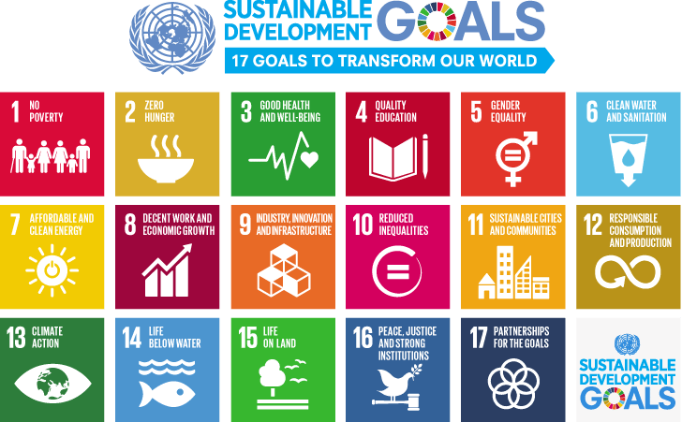
1.2 The SDGs at a glance
Reflect on the following:
What comes to mind when you think about global challenges that affect our planet and its people, and how do you think young people can contribute to addressing them?
1.2 The SDGs at a glance

Slide 13
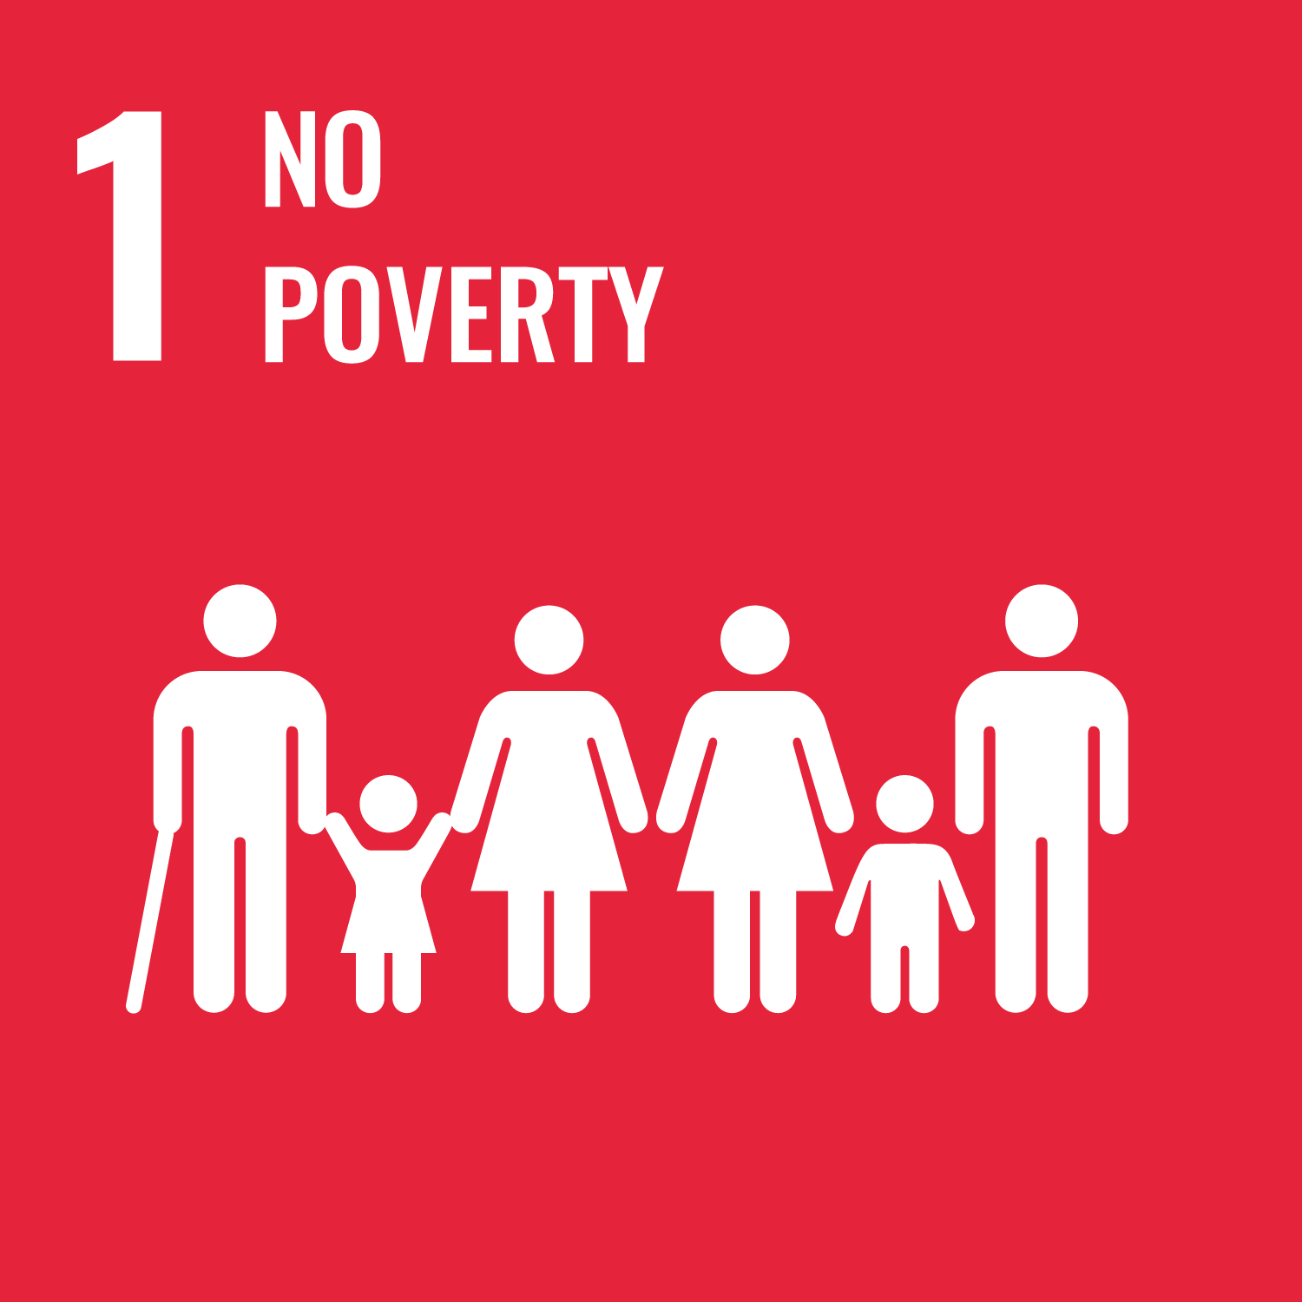
Below, you'll discover a concise list featuring short descriptions of each Sustainable Development Goal (SDG), providing a quick overview of their significance.
If you're eager to delve deeper, we've included a link for more detailed explanations.
1.2 The SDGs at a glance
Goal 1: End poverty in all its forms everywhere - No Poverty
Goal 2: End hunger, achieve food security and improved nutrition and promote sustainable agriculture -
Zero Hunger
Goal 3: Ensure healthy lives and promote well-being for all at all ages - Good Health and Well-being
Goal 4: Ensure inclusive and equitable quality education and promote lifelong learning opportunities for all -
Education
Goal 5: Achieve gender equality and empower all women and girls - Gender Equality
Goal 6: Ensure availability and sustainable management of water and sanitation for all - Clean water and Sanitation

Slide 14
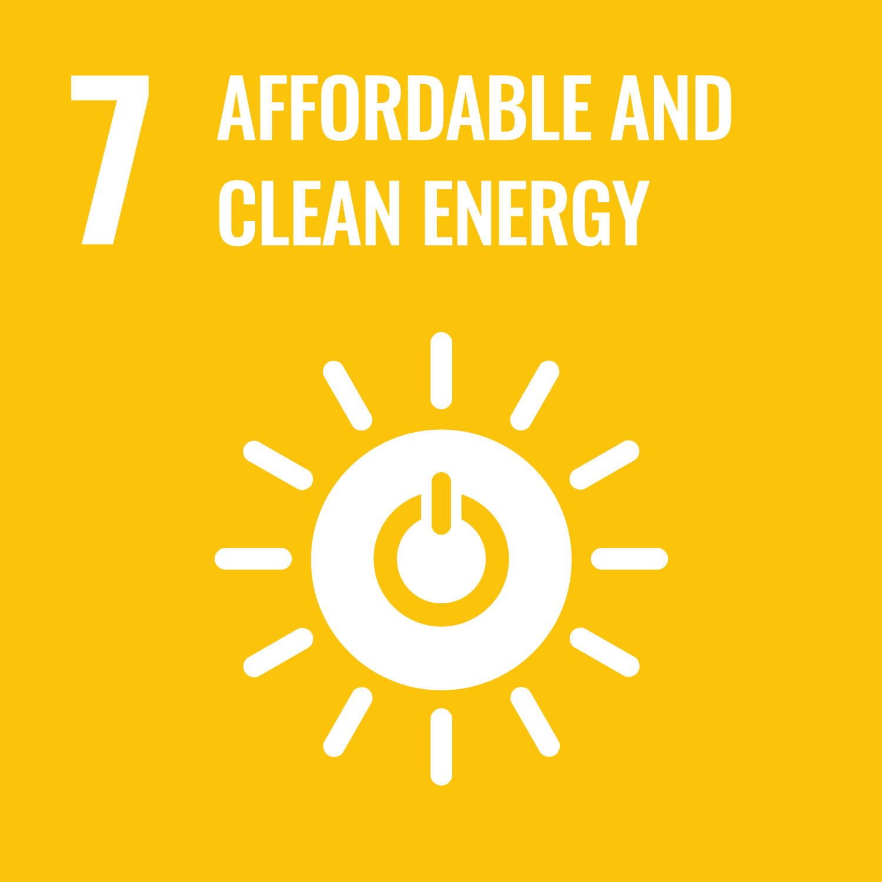
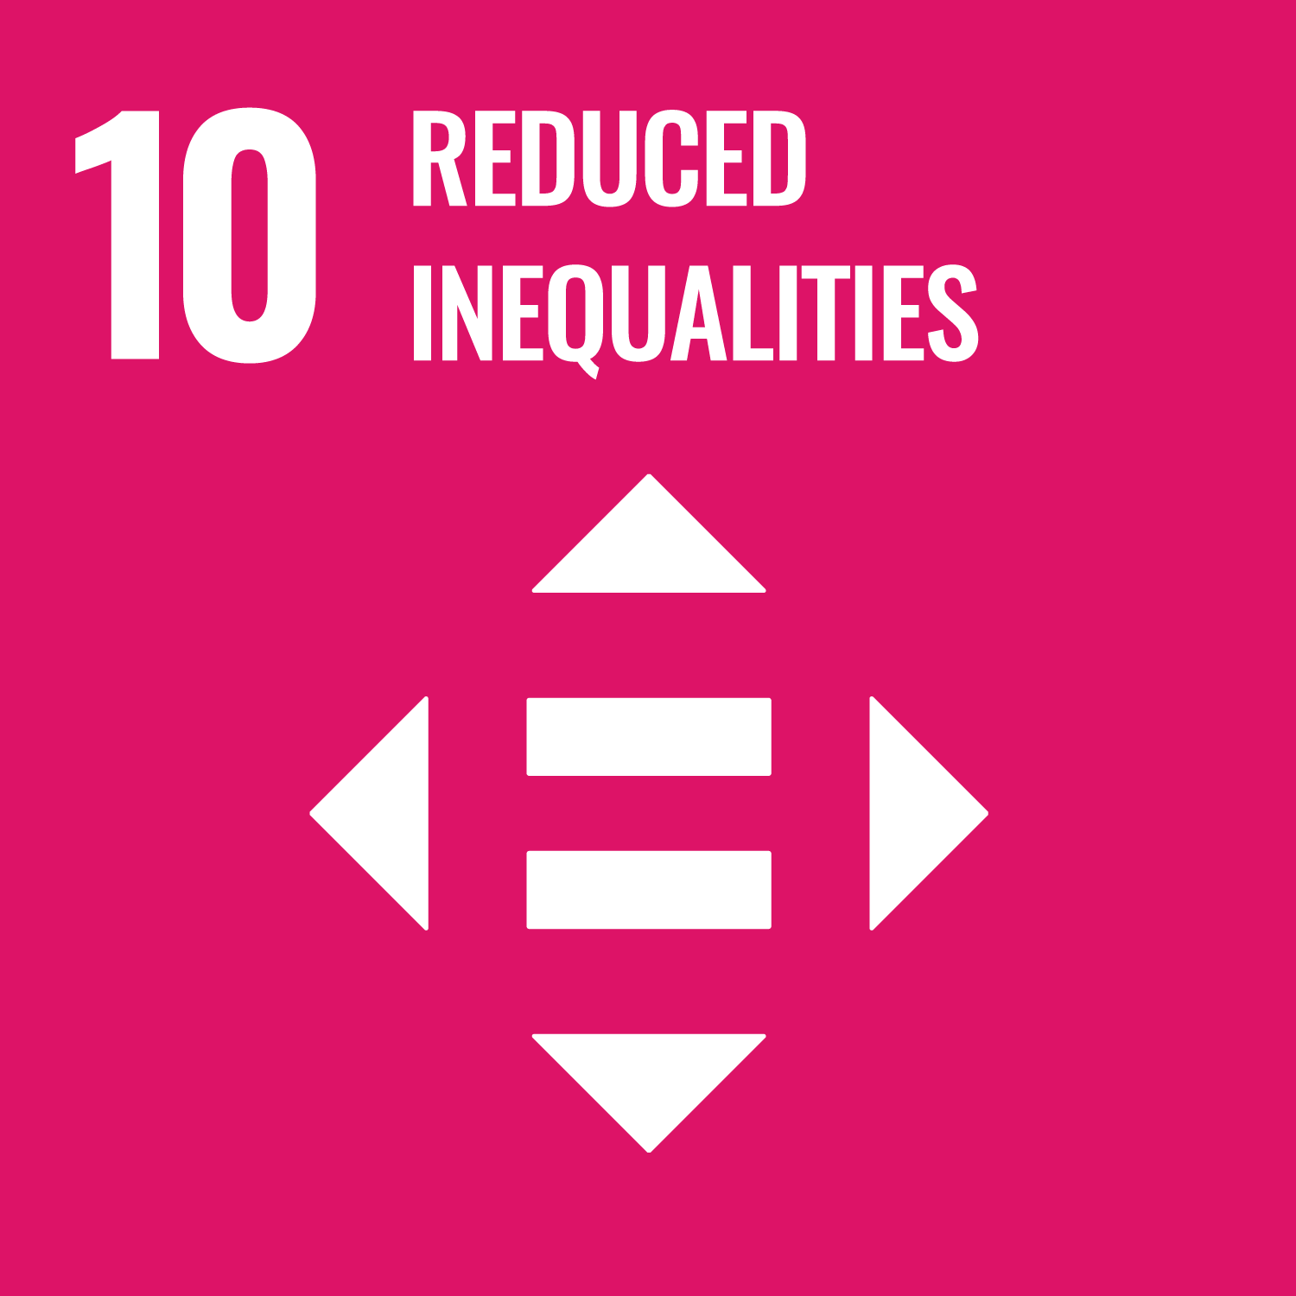
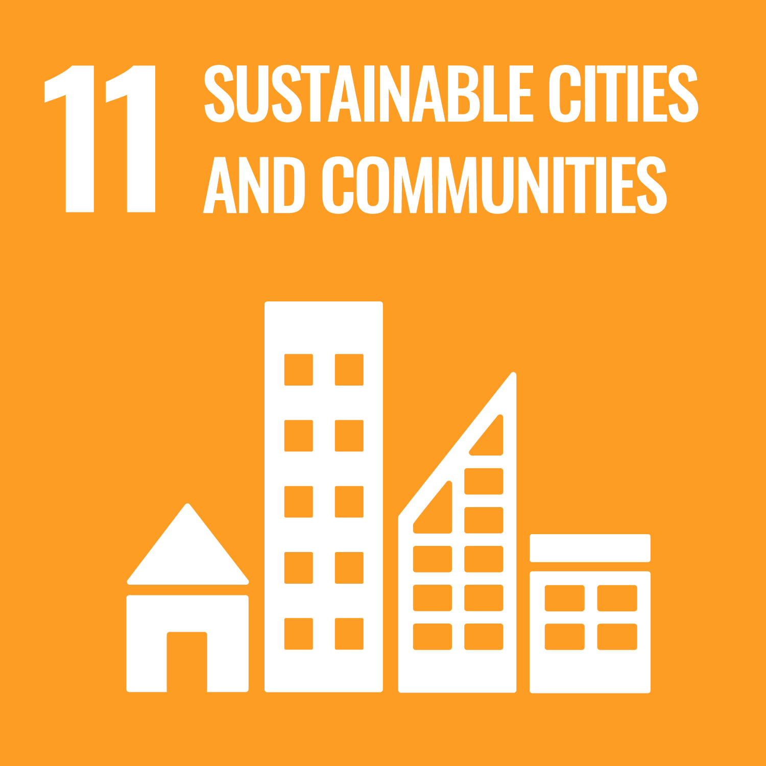
Goal 7: Ensure access to affordable, reliable, sustainable and modern energy for all
Affordable and clean energy
Goal 8: Promote sustained, inclusive and sustainable economic growth, full and productive employment and decent work for all Decent work and economic growth
Goal 9: Build resilient infrastructure, promote inclusive and sustainable industrialization and foster innovation - Industry, Innovation and Infrastructure
Goal 10: Reduce inequality within and among countries - Reduced Inequalities
Goal 11: Make cities and human settlements inclusive, safe, resilient and sustainable -Sustainable Cities and Communities
Goal 12: Ensure sustainable consumption and production patterns - Responsible Consumption and Production
1.2 The SDGs at a glance

Slide 15
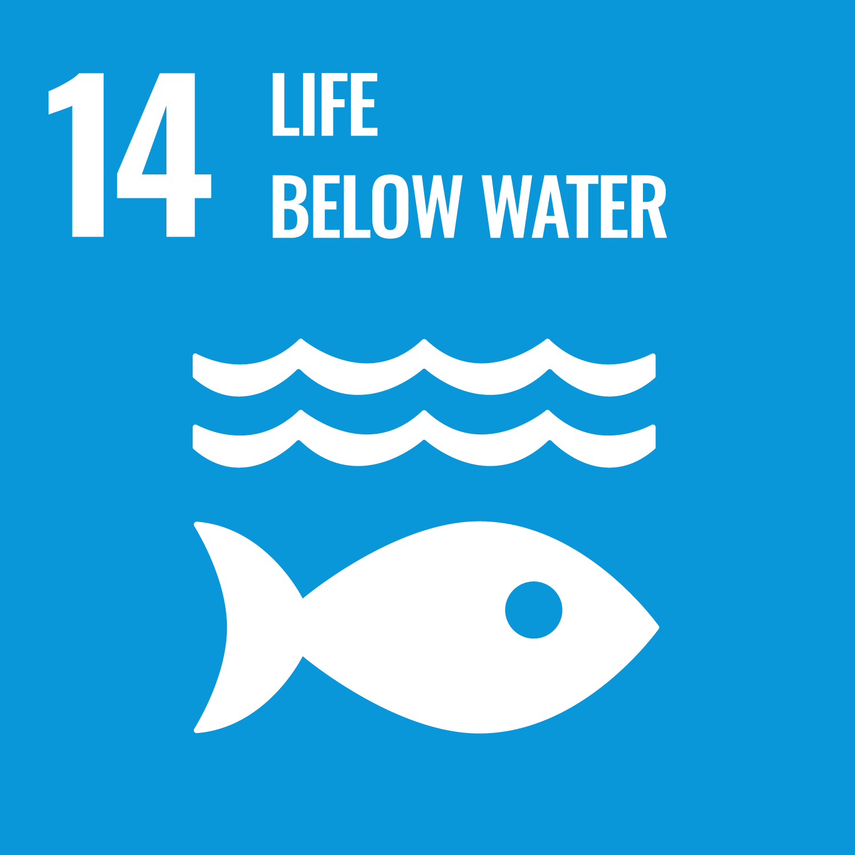
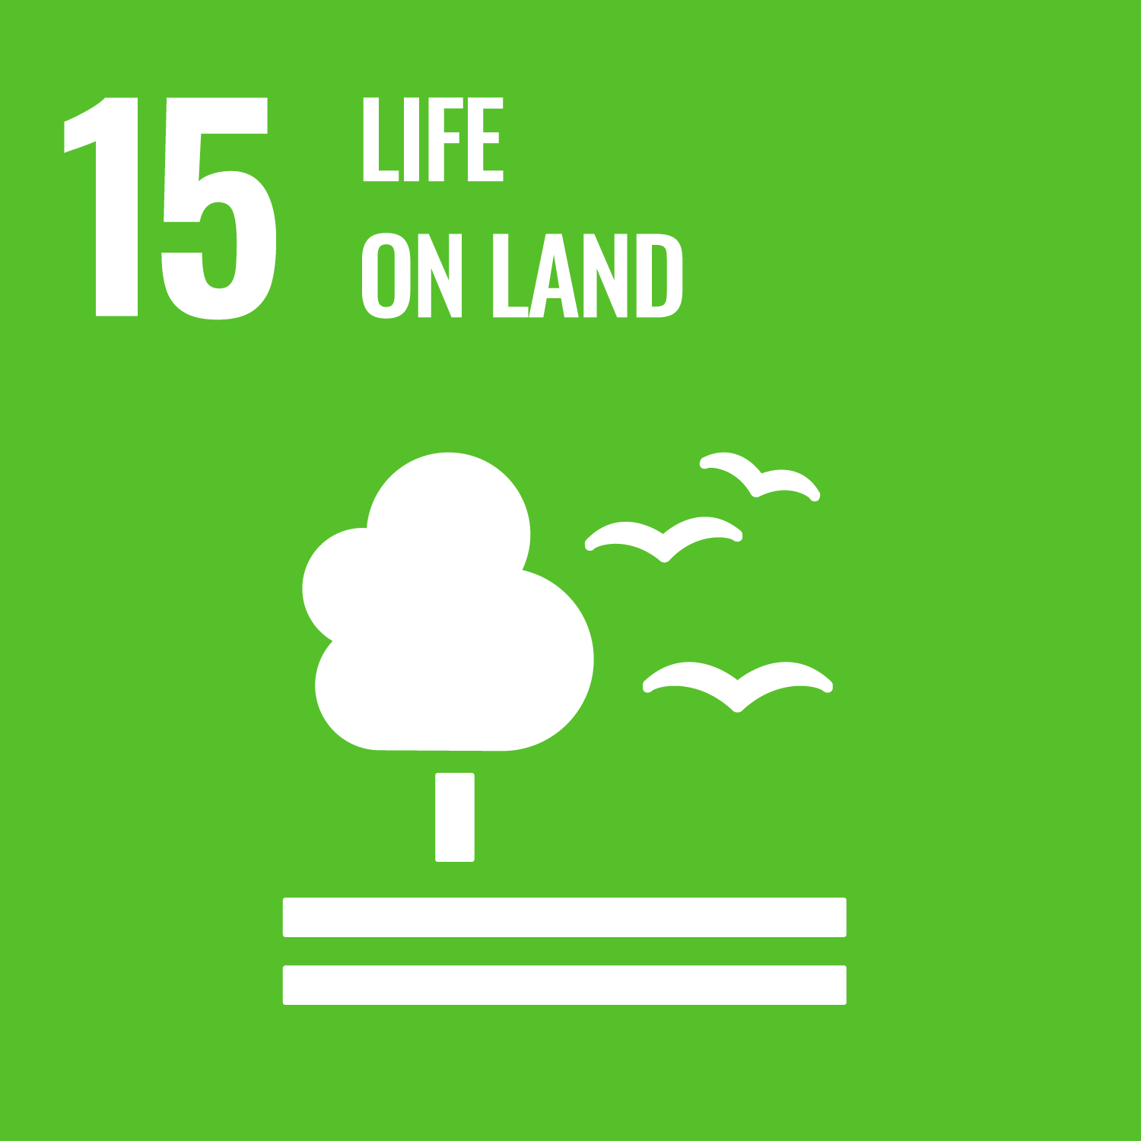
Goal 13: Take urgent action to combat climate change and its impacts - Climate Action
Goal 14: Conserve and sustainably use the oceans, seas and marine resources for sustainable development - Life Below Water
Goal 15: Protect, restore and promote sustainable use of terrestrial ecosystems, sustainably manage forests, combat desertification, and halt and reverse land degradation and halt biodiversity loss - Life on Land
Goal 16: Promote peaceful and inclusive societies for sustainable development, provide access to justice for all and build effective, accountable and inclusive institutions at all levels - Peace, Justice, and Strong Institutions
Goal 17: Strengthen the means of implementation and revitalize the global partnership for sustainable development - Partnerships for the Goals
1.2 The SDGs at a glance

Slide 16
1.3 The principles contained in 2030 Agenda
The principles outlined in the 2030 Agenda serve as fundamental guidelines for global development efforts. They provide a framework to address complex challenges and promote sustainable development. Each principle has a specific purpose:
Integral: Considering the interdependence of different elements, aiming for holistic and integrated solutions to complex challenges.
Inclusive: Ensuring the active participation and representation of diverse stakeholders, fostering a sense of belonging and shared responsibility.
1.3 The principles contained in 2030 Agenda
Leave no one behind: Ensuring that development efforts benefit all individuals and communities, with a focus on inclusivity and reaching marginalized or vulnerable populations.
Universal: Applicable and relevant to all countries and communities, emphasizing shared responsibility for addressing common global issues.

Slide 17
1.3 The principles contained in 2030 Agenda
The principles outlined in the 2030 Agenda serve as fundamental guidelines for global development efforts. They provide a framework to address complex challenges and promote sustainable development. Each principle has a specific purpose:
Measurable: Establishing clear and quantifiable indicators to track progress, ensuring accountability, and facilitating effective monitoring of development goals.
Global in nature: Acknowledging the interconnectedness of global challenges and emphasizing the need for international cooperation and collective action.
1.3 The principles contained in 2030 Agenda
Multi-dimensional: Addressing various aspects and dimensions of development, recognizing the interconnectedness of social, economic, and environmental factors.
Based on experience: Informed by past lessons and practical knowledge, acknowledging the value of learning from prior endeavors.

Slide 18
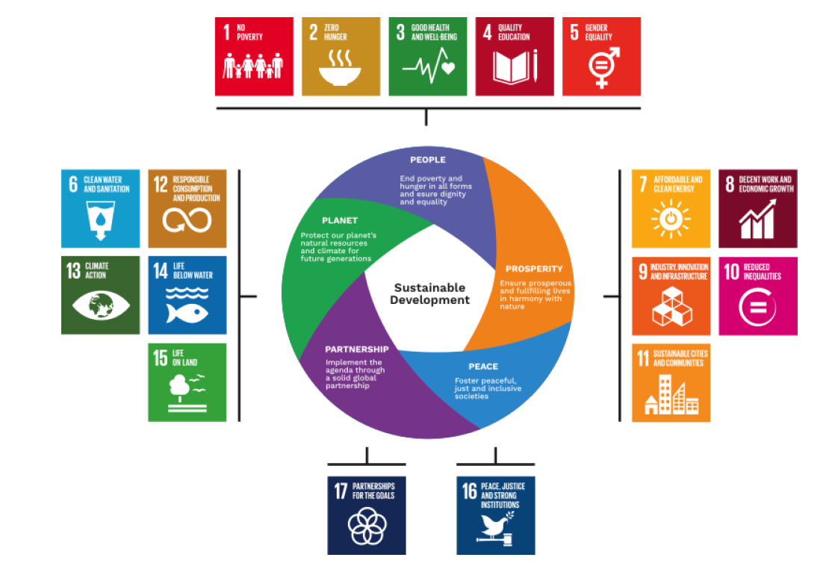
1.4 The Five Pillars of Agenda 2030
SDGs are divided into 5 categories: people, prosperity, planet, peace, and partnership.
This categorization reflects the thematic focus of each group of goals:
1.4 The Five Pillars of Agenda 2030

Slide 19
People: addressing human well-being and equity - end poverty and hunger (goals 1, 2, 3, 4 and 5)
Peace: promoting peaceful, just, and inclusive societies that are free from fear and violence (goal 16)
Planet: ensuring environmental sustainability - protect the planet from degradation (goals 6, 12, 13, 14 and 15)
Prosperity: fostering inclusive economic development (goals 7, 8, 9, 10, 11)
Partnership: strengthening global collaboration (goal 17)
1.4 The Five Pillars of Agenda 2030
Exercise: Go Goals! (optional, if you consider it appropriate and have enough time) - Downloadable Material - Go Goals! SDG board game - downloadable board, questions, and instructions

Slide 20
02
Young Social Entrepreneurs
and SDGs
For social entrepreneurs, understanding and aligning with the principles of sustainable development is paramount.
The SDGs offer a framework for social entrepreneurs to address pressing global challenges while creating sustainable and impactful solutions.
Social entrepreneurs play a crucial role in driving positive change and contributing to the achievement of SDGs through innovative and socially responsible business practices.

Slide 21
2.1 Why Social Entrepreneurs should approach SDGs?
Big Global Goals - Big Opportunity for youth’s ideas and creative energy
The SDGs present not just a set of challenges but, more importantly, a multitude of opportunities for innovation, growth, and societal betterment.
Aligning your business with the SDGs is not merely a trend; it is a strategic decision that can bring about positive transformations for both your enterprise and the communities you serve.
By understanding the interconnected nature of global challenges and actively participating in solutions, you can contribute to building a more sustainable and equitable world.
2.1 Why Social Entrepreneurs should approach SDGs?

Slide 22
Here is why you should consider integrating the SDGs into your entrepreneurial endeavor:
Purposeful impact: The SDGs provide a roadmap for addressing some of the world's most pressing issues, from poverty and inequality to climate change. By aligning your business with specific SDGs, you are contributing to a collective global effort to create positive change and improve lives.
Market opportunities: Consumers are increasingly seeking products and services that align with their values, including sustainability and social responsibility. Aligning with the SDGs not only appeals to a socially conscious consumer base but can also open up new market opportunities and enhance your brand's reputation.
2.1 Why Social Entrepreneurs should approach SDGs?

Slide 23
Partnerships and collaborations: Aligning with the SDGs can facilitate partnerships with like-minded organizations, both locally and globally. Collaborative efforts amplify impact and create a network of support, resources, and expertise that can accelerate your business growth.
Innovation and adaptability: The SDGs encourage innovative thinking and problem-solving. By addressing these global challenges, you cultivate a culture of innovation within your business, fostering adaptability and resilience in the face of changing circumstances.
2.1 Why Social Entrepreneurs should approach SDGs?
In short, answering the “Why”:
to be better prepared to get a job or to consider self-employment as an option for the future
because you can combine global goals with your community and personal benefits

Slide 24
2.2 How Social Entrepreneurs should approach SDGs?
Reflect:
If I had the power, what global problem would I solve, and how would it help me and others?
2.2 How Social Entrepreneurs should approach SDGs?

Slide 25
The alignment with SDGs provides a robust framework for social entrepreneurs to channel their passion and efforts towards achieving meaningful and impactful outcomes.
Understand local contexts: Tailor initiatives to the specific needs and contexts of the communities you aim to serve. Understanding the local nuances ensures that solutions are culturally sensitive and more likely to be embraced by the target audience.
Integrate SDGs into business models: Embed the principles of SDGs into the core of your business model. Identify which specific SDGs align with your mission and develop strategies to integrate them into your products, services, and operations
Measure and report impact: Establish clear metrics and indicators to measure the impact of your initiatives. Regularly monitor and report on progress toward SDG-related goals. Transparent reporting enhances accountability and demonstrates the tangible outcomes of your efforts.
2.2 How Social Entrepreneurs should approach SDGs?

Slide 26
Engage stakeholders: Involve key stakeholders, including community members, customers, and partners, in the decision-making process. Collaborative approaches ensure that initiatives are more inclusive, sustainable, and aligned with the genuine needs of the community.
Build partnerships: Foster partnerships with organizations, both within and outside your sector, that share similar goals. Collaboration allows for the pooling of resources, expertise, and networks, leading to a more significant and lasting impact.
Promote innovation: Encourage innovation in your approaches. Social entrepreneurs are well-positioned to bring fresh perspectives and creative solutions to address complex challenges outlined in the SDGs. Embrace innovation as a means to enhance the effectiveness and scalability of your initiatives.
2.2 How Social Entrepreneurs should approach SDGs?

Slide 27
In short, answering the “How”:
Keeping in mind that the challenges addressed by the SDGs are integrated and must be pursued in combination, rather than one at a time. As a result, SDGs cannot be ordered by priority, all are equally important and work in harmony with the other.
Each goal should be analyzed and pursued with full regard to the three dimensions of sustainable development: economic, social, and environmental.
For each of the 17 Goals there are many positive actions you can take to make a real change
Identify what is needed and chart out long-term pathways to achieve sustainable development
2.2 How Social Entrepreneurs should approach SDGs?
In summary, embracing goal-based planning within the context of the SDGs empowers individuals and organizations, especially social entrepreneurs, to contribute meaningfully to a more sustainable and equitable world.

Slide 28
01
You've reached the end of module 1!
Now it's time for some self-assessment and exercices.

Slide 29
Exercise - Innovative Solution Roadmap
First, define the problem you are addressing:
Which is the global goal you are addressing?
What is the specific problem you want to solve?
Where is this problem happening? (continent, country, region, etc.)
Who are the people affected by the problem? (target group addressed)
What is the solution you are offering to them? (product or service created)
Exercise - Innovative Solution Roadmap

Slide 30
Afterward, you need to know who is also working on the same issue and what is already done to tackle the problem. This way, you can build upon the ideas of others or even collaborate with them in order to reach your target:
Who is working on the same global goal?
Who is working on the same specific problem?
Where is this problem happening? (continent, country, region, etc.)
Who are the people affected by the problem? (target group addressed)
What is the solution you are offering to them? (product or service created)
Exercise - Innovative Solution Roadmap

Slide 31
01
Self-assessment
What does the abbreviation SDGs stand for?
Sensitive Development Goals
Smart Development Goals
Sustainable Development Goals
Strong Development Goals
Selected Development Goals
Self-assessment

Slide 32
02
Self-assessment
Who adopted the Sustainable Development Goals (SDGs)?
the Organisation for Economic Co-operation and Development (OECD)
the World Health Organization (WHO)
the United Nations (UN)
the European Union (EU)
Self-assessment

Slide 33
03
Self-assessment
The SDGs came into force on 1 January 2016. By when should they be achieved?
2020
2030
2050
2099
Self-assessment

Slide 34
04
Self-assessment
How many goals does the Agenda 2030 for Sustainable Development include?
10
15
17
25
Self-assessment

Slide 35
05
Self-assessment
The SDGs include 17 Goals and a total of 169 Targets.
Can you tick off the areas that you know the SDGs are addressing?
Self-assessment
Poverty
Hunger
Health
Education
Gender equality
Water
Energy
Decent work and growth
Industry and infrastructure
Inequality
Cities
Consumption and production
Climate
Oceans and wildlife
Peace and justice
Institutional partnership

Slide 36
06
Self-assessment
Are the SDGs and their targets adequate to address the needs and objectives of sustainable development?
Self-assessment
Yes, they are a valuable framework
No, they are not
Yes, but there is room for improvement

Slide 37
07
Self-assessment
Which are the main areas of SDGs?
Planet
People
Flowers
Prosperity
Cars
Partnership
Peace
Toy stores
Self-assessment

Slide 38
08
Self-assessment
Why Social Entrepreneurs should approach SDGs?
By addressing the SDGs, social entrepreneurs can directly contribute to improving the well-being of communities and fostering positive societal change.
Social entrepreneurs who align with the SDGs can differentiate themselves in the market, attracting socially conscious consumers and building brand loyalty
Addressing social issues, social entrepreneurs can buy expensive cars.
By incorporating SDG targets into their business models, social entrepreneurs can access a broader range of funding opportunities to support their ventures.
A social enterprise is a business which has nothing to do with SDGs.
Self-assessment

Slide 39
Self Assessment - Answers
What does the abbreviation SDGs stand for?
Answer: c. Sustainable Development Goals
Who adopted the Sustainable Development Goals (SDGs)?
Answer: the United Nations (UN)
The SDGs came into force on 1 January 2016. By when should they be achieved?
Answer: b. 2030
How many goals does the Agenda 2030 for Sustainable Development include?
Answer: c. 17
The SDGs include 17 Goals and a total of 169 Targets.
Can you tick off the areas that you know the SDGs are addressing?
Answer: all of them
Are the SDGs and their targets adequate to address the needs and objectives of sustainable development?
Answer: a. and c.
Which are the main areas of SDGs?
Answer: planet, people, prosperity, partnership, peace
Why Social Entrepreneurs should approach SDGs?
Answer: a, b, d
Self-assessment

Slide 40
ADDITIONAL RESOURCES
SDG Good Practices - A compilation of success stories and lessons learned in SDG implementation - https://sdgs.un.org/publications/sdg-good-practices-2020
Training manual for social entrepreneurs Social Entrepreneurship Training Manual - European Comission
Getting started with SDGs - UN - pdf. to be downloaded https://sustainabledevelopment.un.org/index.php?page=view&type=400&nr=2217&menu=1515 (new version platform)
We the people - https://www.youtube.com/watch?v=RpqVmvMCmp0
Transitioning from the MDGs to the SDGs- https://www.youtube.com/watch?v=5_hLuEui6ww
No point going halfway - https://www.youtube.com/watch?v=DdLqiTvFwJk
Leave no one behind - https://www.youtube.com/watch?v=pBqe8JD62QE&t=149s
Numbers in action - https://www.youtube.com/watch?v=Mdm49_rUMgo
United Nations - SDG Actions Platform - https://sdgs.un.org/partnerships
SDG Actions Platform - https://sdgs.un.org/2030agenda
https://commission.europa.eu/select-language?destination=/media/23163

Slide 41
01
You've completed module
Have you also taken a look at the other modules and the guides?
Modules
01 Introduction to SDGs
02 Social Business Model Canvas and Pricing
03 Networking and Communication
04 Digital Marketing and Social Media
Guides
01 Environmental degradation in Business
02 Gender Equality in Business
03 Digital Tools in Industry 4.0 & 5.0 Shaping Entrepreneurship in the New Digital Society

Slide 42
For more information, go to:
https://suse-theproject.eu/
Funded by the European Union. Views and opinions expressed are however those of the author(s) only and do not necessarily reflect those of the European Union or the granting authority, EISMEA. Neither the European Union nor the granting authority can be held responsible for them.

