Slide 1




SUSE The Project
Module 3 - Communication & Networking
Project nr: 2022-2-RO01-KA220-YOU-000102027

Slide 2








Objectives:
  Create awareness of SE among youth as an (self) employment opportunity in the future and increase employability in the short & long term
  Fostering entrepreneurial skills to improve entrepreneurial opportunities and to empower youth to act as intrapreneur.
  Fight youth unemployment across Europe
  Activate young people by involving them in finding solutions for social problems in the local community focused on sustainability
  Encourage youth workers to guide and support youth to play an active role in society and educate them how to apply digital coaching
  Bring attention to the need of actively inspire youth to become social entrepreneurs
  Bridge the gap between youth and business by connecting youth and entrepreneurs
WHAT IS SUSE?
SUSE is a programme which is aimed at improving employability and give young people the opportunity to learn about social entrepreneurship, to be self-employed and simultaneously work on environmental issues in society. This local approach will encourage young people to become part of the community and stimulate active citizenship
Powered by:

Slide 3
SUSE MODULES
Sustainable Young Entrepreneurs
01
Introduction to SDGs
02
Social Business Model Canvas and Pricing
03
Networking and Communication
04
Digital Marketing and Social Media

Slide 4
SUSE GUIDES
Sustainable Young Entrepreneurs
01
Environmental degradation in Business
02
Gender Equality in Business
03
Digital Tools in Industry 4.0 & 5.0 Shaping Entrepreneurship in the New Digital Society

Slide 5


INTRODUCTION
Watch SUSE Video Module 3 https://www.youtube.com/watch?v=Ygt3-X0ZGE0&list=PLcG96fou9ugIcS3ZYVFc5SNQNJo3JhIfH&index=3
This module emphasizes the critical importance of effective communication and networking in the realm of social entrepreneurship. In the context of social entrepreneurship, where positive impact and collaboration are paramount, the ability to communicate effectively and build strong networks becomes a determining factor for success. This module provides participants with the skills, knowledge, and competencies needed to communicate effectively and forge meaningful connections that drive the progress of their social entrepreneurship projects.

Slide 6



OBJECTIVES
  Introduce the concepts of networking and communication to the young learners.
  Make the young learner understand the importance of networking and communication in social entrepreneurship ventures.
  Enable the young learner to communicate and network effectively.
  Provide the young learner with the capacity to evaluate the impact of their communication & networking efforts, and adapt these if needed.

Slide 7


EXPECTED LEARNING OUTCOMES
Upon completion of this module, trainees should:
  Understand the concepts of networking and communication;
  Understand the importance of networking and communication in social entrepreneurship ventures;
  Be able to communicate effectively;
  Be able to network effectively;
  Know how to evaluate and assess the impact of their communication and networking efforts.

Slide 8





01
Communication
focuses on effective communication, crucial for social entrepreneurship success.

Slide 9



3.1.1
Effective communication
Effective communication is an essential interpersonal ability. To succeed in social entrepreneurship, we must be able to communicate effectively. Communication is more than simply transferring information. It is about comprehending the feelings and intentions underlying the material.
To be great communicators, we must be aware of potential BARRIERS - various characteristics or conditions that impede the effective sharing of ideas or thoughts - and learn to deal with them.

Slide 10
3.1.1
Effective communication
When conversing, look out for potential communication barriers:
  Physical barriers include closed doors that impede teamwork, noise that disrupts a meeting, distance that might cause communication breakdowns, and so on.
  Semantic and language barriers: lack of clarity, words with many meanings, lack of specificity.
  Socio-psychological hurdles include stress, distrust, and divergent mindsets.
  Organisational impediments include a lack of communication policies and poorly defined responsibilities within the company.
  Cross-cultural difficulties include differences in thinking, beliefs, ideas of time and space, and the meaning of gestures.

Slide 11



Slide 12

COMMUNICATION
  Some hurdles can be addressed by better organisation, while others require good communication skills such as active listening and empathy, questioning and reflection, effective speaking, storytelling, and nonverbal communication.
  Despite our best intentions, what we try to express can be lost in translation. Fortunately, with work and practice, everyone can improve their communication skills.

Slide 13
3.1.2
Listening
Being an effective communicator is more than just what you say and how you say it. It also requires being a good listener. When you know someone is truly listening to you, the degree of attention makes you feel appreciated, safe, understood, and significant. On the contrary, when the other person does not actively listen, you feel neglected and smaller.
Listening is just as crucial in business communication. By listening properly, you can gain more knowledge, boost others' trust in you, lessen conflict, better understand how to encourage others, and inspire a higher degree of dedication in those you manage. Active listening is essential in negotiations because it allows you to investigate and grasp another person's point of view.

Slide 14
3.1.2
Listening
Tips and strategies for being a good listener.
  If you expect a conversation, reduce distractions by choosing a quiet area and turning off the sound of your cell phone or other devices.
  Active listening entails being fully present. It involves giving the speaker your total attention.
  Show active listening by making EYE CONTACT with the speaker.
  Communicate your listening mode and empathy with BODY LANGUAGE, such as lightly covering your mouth, smiling, or nodding your head to show that you are paying attention. Examine the speaker's body language and voice: do they sound weary, eager, or confused?
  DO NOT INTERRUPT THE SPEAKER OR CHANGE THE SUBJECT without first reacting or adding to what they have said.
  REPEATING what you've heard can help you know you're paying attention, and they can tell as well.
  Ask OPEN QUESTIONS to learn more and demonstrate that you were truly listening.

Slide 15

LISTENING
Listening is equally important in business communication. By listening effectively, you get more information, increase others’ trust in you, you can reduce conflict, better understand how to motivate others, and inspire a higher level of commitment in the people you manage. Active listening is very important in negotiations as you have to explore and understand the position of another person.

Slide 16
3.1.3
Presentation, pitching and storytelling
Presentation abilities encompass a variety of aspects, including the design of your presentation's structure and visual aids (if applicable), the tone of your voice, the body language you communicate, and so on.
What factors must be considered in order for your presentation to be good, if not great?
  CLEAR MESSAGE - What is the focus of your presentation? Too much information is worse than too little.
  CORRECT FRAMING- Where would you begin and end your story, and how will you limit the scope to include examples?
  EMOTIONAL IMPACT: What was your "aha" moment? How will you inspire and persuade your audience to follow your call to action?
  DELIVERY: Will you utilise notes or slides? Will you memorise your full speech? How will your body language reinforce your message?

Slide 17
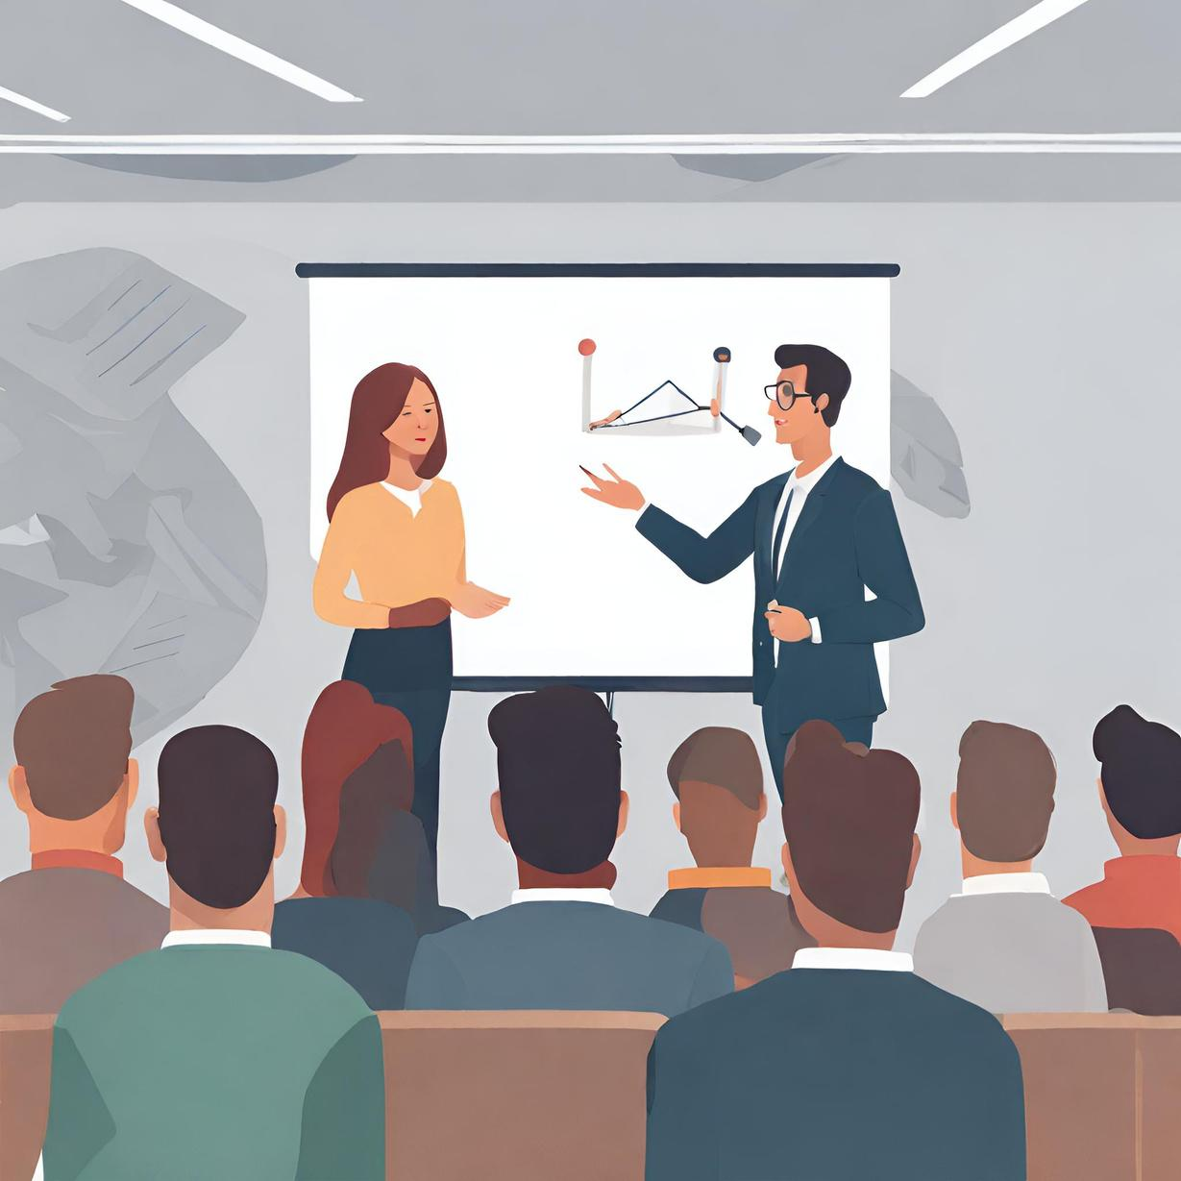
PRESENTATION, PITCHING AND STORYTELLING
Pitching is a popular term in the "start-up" sector that refers to a brief, persuasive speech intended to pique interest in a project or product and keep it in order to proceed with further talks. It is also known as "elevator pitch" (elevator speech or elevator statement) since it is often brief enough to be delivered during an elevator trip. Pitches are one- to five-minute talks that summarise the most significant aspects of a product, service, project, organisation, or job seeker in a few lines. Before delivering a good pitch, it must first be well planned.

Slide 18
3.1.4
Improve your communication skills
Here are some tips on how to improve your communication skills:
  Consider your audience while choosing a communication route and message. How is your relationship? How do they prefer to communicate? Do they prefer email or a meeting?
  Examine the way you speak to others. Clear, deliberate, and courteous communication can help your business.
3. Pay attention to nonverbal cues - body language, including yours. Only a small portion of our conversation is represented by verbal information exchange. The remaining factors are body language, speech tone, and energy level.
4. Make an effort to practise communication skills such as listening, storytelling, and pitching, and seek feedback from your partners and colleagues. When we devote time to practising communication skills, we invest in ourselves.

Slide 19
02
Networking
Networking is crucial for social entrepreneurs, facilitating the exchange of ideas and resources.

Slide 20
3.2.1
Why is it important to have a network
Expanding your network and possibly gaining Networking, which is defined as the "exchange of information, knowledge and ideas between people who share a common profession or special interest" (Investopedia, 2022), is a must-do for professionals. It allows you to gain access to new ideas and resources.
Stories and experiences of others can inspire you, if you want to get a better idea of what networking entails for social entrepreneurship you can watch this video:
https://youtu.be/PFnH1RbUmaY?si=ohKRlttX_VXqjSXL
Networking is essential for social entrepreneurs as it fosters collaboration, innovation, and access to resources. By connecting with like-minded individuals and professionals, social entrepreneurs can gain support, insights, and partnerships that amplify their impact. Establishing relationships within the business community is crucial for accessing funding, mentorship, and other vital resources. In summary, networking is indispensable for both personal and enterprise growth in the realm of social entrepreneurship.

Slide 21
3.2.2
Finding connections
Finding the people and organisations that are crucial to the success of your company includes mapping relevant key stakeholders and actors in networking. But before you start thinking of whom to network with, you need to think about what you want to achieve with networking. Networking and establishing connections and solid relations requires time, and with time being one of the most scarce resources in one´s life, it is important to use it well.
So reflect upon the “why”, do you want to tap into new markets or channels, do you want to collaborate for distribution or marketing purposes, do you want to learn more about running a social enterprise, or maybe you need help with a very specific challenge or problem.

Slide 22
FINDING CONNECTIONS
Once you have determined clearly what you want to achieve, you can start to scan through your ecosystem and research if there are networking events organised in your area. Analyse each of them carefully and make a list of the persons and events which can contribute to achieving the objective and reason your networking.
Our recommendation is that you start your networking efforts by compiling a list of all your professional contacts. This list should contain details about your interests, the contacts' areas of expertise or activity, and any ways in which you could learn from or collaborate with them. As well as contact information that facilitates interaction between the parties. Below is an example of such a table.
Name/
Organisation
Field of activity
Contact
info
Why?
How can be helpful?
Other
relevant info

Slide 23
3.2.3
Networking in “real life”
OK so now you have a clear idea on why you want to network, what you want to achieve and who you could potentially contact.
First of all bear in mind, there is no fool proof method for networking; chances to forge a professional connection can arise in nearly any aspect of your day-to-day work, so it's important to be ever-prepared. You should keep in mind that networking is something that can be done at any time. If you're interested in meeting someone, don't be shy about sending a contact request or striking up a casual conversation over coffee at a nearby cafe.
In short, it can occur at:
  Formal networking events organised specifically for the purpose of connecting people;
  Conferences, seminars, workshops, trade fairs and training;
  Business related social events (e.g. a business lunch);
  Referrals from other professionals or even friends and families;
  Social networks;
  Informal settings (e.g. sport activity).

Slide 24
3.2.3
Networking in “real life”
You can network face-to-face or online, but both have the following in common:
  Find a way to break the ice. An awkward situation can be quickly overcome by offering a compliment, which helps to create a positive first impression. Or you prepare a short jokes or witty remarks that ease any tension and awkwardness.
  Be positive and open minded. Engaging in a networking event with a positive mindset and an open attitude, helps not only to enjoy the events, but creates more space to exchange ideas, contacts, experiences, best practices, etc., indeed they can be fun.
  Be clear: Think about how your interests and goals align with those of the people you meet. Don’t be afraid to ask for what you want. Just make sure that before you attend your next social gathering you have a clear idea what you look for, what you can offer and when someone ask how they can help, be sure to let them know.
  Don't be selfish: networking is about giving and taking. If you are always the one who asks for help and favours, but you are not there when others need help, the partnership is unlikely to last.

Slide 25

AND LAST BUT NOT LEAST “JUST DO IT”
But take note of the stakeholders' surroundings and personality traits before beginning a conversation with them. This will help you determine whether an informal or formal tone is more suitable for your interaction. When in doubt, it is better to be a bit more formal and relax the interaction as you gain confidence on both sides.

Slide 26
3.2.4
Networking on-line
Although the basics of networking explained above are the same if you are doing it “off-line” or “on-line”, not in the least because it allows you to extend your reach enormously and connect to people which are located miles away. Online networking can be especially valuable when facing geographical, time, and financial constraints that limit your ability to network in person or attend events.
With the interactions many times asynchronous and less “noise” from non-verbal communication, when you are networking for the first time as a social entrepreneur you may find that online networking is less intimidating.
Online networking events are organized by various entities to facilitate connections, although webinars can be cumbersome due to limited participant visibility. Therefore, it's recommended to use events specifically designed for networking purposes. Social networks, especially professional ones like LinkedIn, play a vital role in networking. Facebook and other platforms also offer groups for interaction and engagement.

Slide 27
3.2.4
Networking on-line. Why use Linkedin?
1. Through your accounts on LinkedIn, you can show off their skills, experiences, and accomplishments. This makes you stand out to people who might hire or work with you.
Highlight academic achievements and extracurricular activities. Include any awards, honours, or scholarships you've received, and include also any activities you do in your community, e.g. volunteering, training a sports team, etc.
2. You can find out a lot about many different industries by watching companies and influential people on LinkedIn. You can join groups that are focused on certain businesses or areas of interest. This gives you a better idea of the industry and a chance to talk with people who share your interests.
3. LinkedIn lets you find internship and job chances right on the site. A lot of companies only post job openings on LinkedIn or use it as their main way to find new employees and collaborators.

Slide 28

NETWORKING ON-LINE.
In any case, the key to establishing professional relationships in the digital environment is to build a good online presence, remain visible and actively interacting with others through: commenting on publications or blog posts, participating in interviews or webinars, publishing one's progress.
Want to know more: How to Network Online Effectively: A Beginner’s Guide (https://www.careeraddict.com/network-online)
Another important "do" to take into consideration when networking and pursuing professional relationships online, is to observe rules of netiquette, that is, of online behaviour and communication (just as you would in personal dealings!).
Take a look at the video below to understand why following certain rules of behaviour to have a good online reputation and communicate with others (in our networking activity, of course, but also in other basic interactions as professionals): What is Netiquette & Why is it Important? (https://youtu.be/gvkbDc1LiVI?si=aN1GnGPLfUklh2Te)

Slide 29





03
You've reached the end of module 3!
Now it's time for some assignments and exercises to practice what you have learned.
Assignments are to apply the knowledge to your business idea.
Exercises are to practice a particular skill

Slide 30



Assignment: STORYTELLING
Each story has to have a structure, the most common one is the folk tale structure. Cynthia Kurtz (2014), in Working with Stories proposes the following:
  Context – introduction of the setting and characters, explanation of the state of affairs,
  Turning point – the dilemma or problem or initiating event that starts the story rolling,
  Action – how the people in the story respond to the dilemma or problem,
  Reversal – complications, further difficulties, challenges, things going wrong,
  Resolution – the outcome of the story and reactions to it
Storytelling is a powerful way to connect with your (potential) clients, investors and/or supporters, if you already have a business idea you can use the practice below to craft the story of your business. If you have not yet a clear idea, you might want to craft the story on your journey to become an entrepreneur, or maybe to tell the story of a family or friend, or your ancestors.
By answering the 5 questions the outlines of the story of your business/journey will become visible. How you communicate it is up to you, but whatever you do make sure it provides meaning and sense to your business idea.
Assignment 1 Communication
https://www.workingwithstories.org/WorkingWithStoriesThirdEdition_Web.pdf

Slide 31
Assignment: STORYTELLING
The most common one is the 5-part skeleton (similar to the folk story structure mentioned before):
  Opening (setting) – Every day……..
  Rising action (theme, desired state) – But one day….
  Climax (change) – Until finally…..
  Falling action (real transformation) – Because of that ……..
  Ending (conclusion, insight, desired state achieved) – And that is why….
Opening: introduction of the setting and characters, explanation of the state of affairs
- Every day……..
- Once upon a time…..
Rising Action: the dilemma or problem or initiating event that starts the story rolling
- But one day….
- And then….
Assignment 1 Communication
Climax/Change: how the people in the story respond to the dilemma or problem
- Until finally ….
- The situation was becoming….
Falling action: how the people in the story solved the dilemma or problem
- Then things changed….
- Because of that….
FEnding: the outcome of the story and reactions to it
- And that is why….

Slide 32
Assignment: DEFINE YOUR CURRENT NETWORK
As a social entrepreneur you meet many people daily. Taking the time to identify who are the ones at the top of your network and what is your preferable way of networking can give you an insight where your strengths and weaknesses in your networking style lie.
  How do you network most often? Is it at formal or informal social gatherings? Can you identify your 3 strongest networking connections?
  In what possible ways can you prepare for a networking event? Come up with several ice-breakers to start a conversation.
Assignment 2 Networking

Slide 33
Exercise: ACTIVE LISTENING
Being able to communicate effectively starts with being able to listen, and more importantly active listening. It keeps you engaged with your conversation partner in a positive way. It also makes the other person feel heard and valued. This skill is the foundation of a successful conversation in any setting—whether at work, at home, or in social situations.
For this practice you will need to engage 2 more persons, which makes sense, practising communication with yourself is not very effective.
The practice helps to reflect on a question and generate your own solutions using simple principles of active listening. Often, when we reflect and discuss, we tend to focus on multiple individuals and questions at once, moving around our attention and focus. Meanwhile, when we listen to others, we tend to do so in a discussion-oriented way, thinking about “what will I say next”, rather than listening to the other with full presence and attention.
Exercise 1 Communication

Slide 34
Exercise: ACTIVE LISTENING
As said before there are 3 participants, each with a different role:
  The subject: The subject’s role is to explore the question or problem from his/her personal perspective. The person in this role should keep in mind: allow the focus to be on you, and let your reflection flow naturally, being guided by the active listener.
  The active listener: The active listener’s role is to listen with full presence and focus. To listen with the whole body, to be curious, observe, paraphrase what he/she hears and guide the subject with open questions. This person should keep in mind: ask open questions to support the subject’s reflection; do not offer advice; listen with the whole body.
  The observer: The observer’s role is to observe the process without speaking. To make observations from an outside perspective, to see and hear things that the listener and subject may not. This person should keep in mind: stay silent throughout the process; observe and make notes about what you see and hear; after the subject finishes, share the observations with the others.
Exercise 1 Communication

Slide 35
Exercise: ACTIVE LISTENING
Then you set up the question or problem, this what each subject will explore and reflect upon. It could be a common question for all 3 (e.g. “What are the biggest barriers to change in my work and how can I work to overcome them?”) or each subject can set his or her own question or problem (e.g. Choose a challenge in the workplace that you are struggling with currently.)
There are 3 rounds normally, so that each participant experiences each of the roles and learns from it. Each round should last about 15 minutes. Once you finished discuss issues like:
  What happened to me during the exercise?
  How did it feel to be the observer?
  How did it feel to be the subject?
  How did it feel to be the active listener?
  What did I learn about myself?
  How can I apply insights from this exercise?
Exercise 1 Communication

Slide 36
Mapping the Ecosystem or Community
Mapping the Ecosystem or Community focuses on the relationships and connections you have with others, and get an idea of what your own community or ecosystem looks like and what are the relationships you have with the different actors and persons in this community or ecosystem. The resulting map may help you to notice new connections and links between the different elements spotted in the community that may have a positive impact on your life or professional aspirations.
A Community or Ecosystem Map is valuable and effective, simply because the maps are visual and relatable, while focusing on the resources, opportunities and strengths of the community or ecosystem and identify those which are relevant for your own goals.
The main aim of the practice is to reflect on your community as a whole and the way it has an impact in your lives. Focus on what the resources are, what you value the most, which are the things that make your community be what it is,...
With your thoughts you actually fill the “map” to create a visual representation, whether using individual templates for each participant in the activity, or a big piece of paper in which to draw the “ecosystem/community map” and linking assets, opportunities, strengths, support groups, etc.
Put our name in the centre and add the different elements identified to the map. Try to place those elements that have a major impact on you closer to the centre, and once all the identifying elements are placed on the map or worksheet, you can start tracing connections among them.
Exercise 2 Networking

Slide 37
Mapping the Ecosystem or Community
You can use different types of lines or colours to identify different sorts of relationships among the individual(s) and the elements of the community displayed on the map (important people, caring relationships, valuable assets, organisations or entities working toward a better future for the community, job/training opportunities,...).
Things to consider:
  Individuals/groups in your immediate environment that you have direct contact (physical/virtual) with (direct connections).
  Individuals/Groups/Factors that are important and impact you, but you are not in direct contact with them (indirect connections).
  Social and cultural values/customs/groups/experiences that impact you and those around you.
Then, take a few more moments to have a look at the map and reflect about it. Is there anything else missing? Are there any other connections that are not drawn on the map yet? Make as many modifications as necessary.
Then reflect upon the map by asking yourself the following questions:
  How did that make you feel?
  What were your thoughts as you slashed through the map?
  Can you identify any new opportunity for a better future you haven’t thought about before?
  Should any third part be involved in the analysing my map?
Exercise 2 Networking

Slide 38
ADDITIONAL RESOURCES
Networking
Publications/papers/books
  11 Tips for Successful Business Networking | ZenBusiness Inc.
  https://www.zenbusiness.com/blog/networking/
  How to Professionally Network as a Small Business Owner
  https://business.tutsplus.com/tutorials/professional-networking--cms-26929
  Meaningful conversations
  https://mymarketability.com/blog/10-killer-networking-questions-that-spark-meaningful-conversation
  What is Netiquette? 20 rules Internet Etiquette Rules
  https://www.kaspersky.com/resource-center/preemptive-safety/what-is-netiquette
  Netiquette: How to Master Online Business Communication
  https://www.business-opportunities.biz/2020/05/05/netiquette-master-online-business-communication/
Videos
  A General Guide to Netiquette
  https://youtu.be/eq4sNeuAcJw?si=-rLbed9efsr36MDX
  Networking for NGO leaders
  https://youtu.be/4ARTXfY8Yhw?si=XHh7Rw2Mk6ol9IOC
  How To Make A Business Partnership Work
  https://youtu.be/fG_NBTeNN2s?si=hlqoQ5Uf94G9H3Mw

Slide 39
ADDITIONAL RESOURCES
Communication
Publications/papers/books
  The 10 Communication Skills Every Entrepreneur Must Master
  https://www.entrepreneur.com/leadership/the-10-communication-skills-every-entrepreneur-must-master/252555
  Improving skills of social entrepreneurs
  https://www.isseproject.eu/share/uploads_resources/335a6-self-learning-interactive-handbook-isse-final.pdf
  5 Communication Skills Successful Entrepreneurs Use To Influence Others
  https://www.forbes.com/sites/ryanrobinson/2019/12/13/communication-skills-entrepreneurs/
  The Role of Effective Communication in Entrepreneurial Success
  https://www.entrepreneur.com/en-in/growth-strategies/five-prime-benefits-of-effective-communication-in/336347
Videos
  How to improve your communication skills
  https://youtu.be/mPRUNGGORDo?si=hXjm-rk1Nl1pmuOq
  Think Fast, Talk Smart: Communication Techniques
  https://youtu.be/HAnw168huqA?si=K_p-RUl8hG1SlAZ2
  The Pencil's Tale - a story that everyone should hear
  https://youtu.be/HisYsqqszq0?si=NrYSF-iAr457SWMK

Slide 40
03
You've completed module
Have you also taken a look at the other modules and the guides?
Modules
01 Introduction to SDGs
02 Social Business Model Canvas and Pricing
03 Networking and Communication
04 Digital Marketing and Social Media
Guides
01 Environmental degradation in Business
02 Gender Equality in Business
03 Digital Tools in Industry 4.0 & 5.0 Shaping Entrepreneurship in the New Digital Society

Slide 41


For more information, go to:
https://suse-theproject.eu/
Funded by the European Union. Views and opinions expressed are however those of the author(s) only and do not necessarily reflect those of the European Union or the granting authority, EISMEA. Neither the European Union nor the granting authority can be held responsible for them.

